Slide 1
Evacuation migration by libvirt
보라매NOC

Slide 2
목차
EVACUATION
NONE-LIVE MIGRATION
LIVE-MIGRATION
1) Shared storage-based live migration (메모리만 복사)
2) Block live migration (메모리와 블럭디바이스도 복사)
3) Volume-backed live migration
4. VOLUME MIGRATION

Slide 3
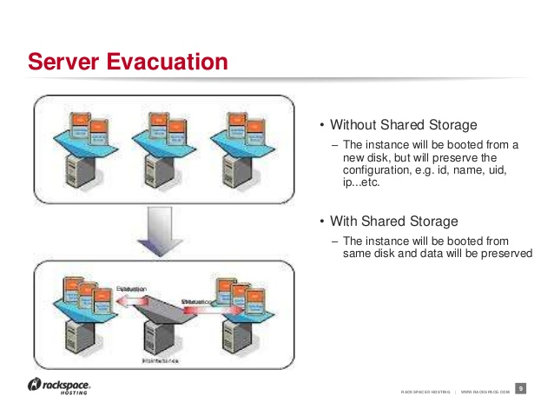
1. Evacuate instance
1. Evacuate instance
- H/W불량 등으로 Host Node가 고장발생시 다른 Node에서 instance를 booting
- target Host는 명시적으로 지정할 수도 있고 scheduler가 선택하게 할 수도 있음
- 공유스토리가 사용하는 경우 , 사용하지 않는 경우로 나뉨
- HOST단위로 할지 instance단위로 할지 명령어상의 결정 가능

Slide 4
1. Evacuate 구성
1. Evacuate 환경설정
- packstack answer 파일에 compute node를 2대의 IP 설정
- /etc/hosts 에 compute node의 설정 및 hostnamectl set-host hostname 설정
- compute nova 관련 서비스 재기동 또는 rebooting
nova service-list , hypervisor-list up 상태 확인
- nova service-list , hypervisor-list에 down 상태 확인 (서버 power off, osc 네트워크 단절)
- nova evacute 명령어 실행
- instance가 상태 및 이동여부 확인 (nova show instance id, virsh list --all)
instance1
instance1
controller
conmpute1
compute2
osc 관리망
※ 동작조건
Controller가 Comute HOST OSC 관리망의 상태를 체크하여 hypervisor,nova service가 down 상태일때 동작

Slide 5
1. Evacuate 네트워크 구성
Evacuate 네트워크 구성
상용망 pgwHOST
TEST HOST
bond0
IPC망
bond1
1.3 EMS망
1.4 OSC망
bond2
LIVE망
ens160
osc망
ens192
서비스망
ens224
LIVE망
망분류 | 상용 | 상용IP | TEST | TEST IP
OSC 관리망 | bond 1.4 | 60.50.81.0/24 | Ens160 | 10.10.10.0/24
서비스망 | bond0 Bond1.3 | 30.8.0.0/16 60.50.80.0/24 | Ens192 | 20.20.20.0/24
LIVE MIG 망 | bond2 | 50.192.169.0/24 | Ens224 | 30.30.30.0/24
※ 상용망과 차이점
ㅇ 상용망에서는 NFVO-> OPENSTACK->대상 HOST
ㅇ 상용망에는 EVACUATION 완료되고 나서 이전 HOST에 virsh list –all에 VM 형상이 남아있는 원인은
nova.conf파일의 destroy_after_evacuate=false에 의해 결정 (false->true로 변경)

Slide 6
1. Evacuate instance
2-1. Evacuate 사전확인
가. To find a host for the evacuated instance, list all hosts
[root@osc ~(keystone_admin)]# nova service-list (openstack nova-compute 상태확인)
+----+------------------+----------+----------+---------+-------+----------------------------+-----------------+
| Id | Binary | Host | Zone | Status | State | Updated_at | Disabled Reason |
+----+------------------+----------+----------+---------+-------+----------------------------+-----------------+
| 1 | nova-consoleauth | osc | internal | enabled | up | 2016-01-31T12:46:03.000000 | - |
| 2 | nova-scheduler | osc | internal | enabled | up | 2016-01-31T12:46:05.000000 | - |
| 3 | nova-conductor | osc | internal | enabled | up | 2016-01-31T12:46:01.000000 | - |
| 4 | nova-cert | osc | internal | enabled | up | 2016-01-31T12:46:05.000000 | - |
| 41 | nova-compute | vgw31-s2 | nova | enabled | up | 2016-01-31T12:46:02.000000 | None |
| 42 | nova-compute | vmme31-3 | nova | enabled | up | 2016-01-31T12:46:03.000000 | None |
[root@osc ~(keystone_admin)]# nova hypervisor-list (hypervisor 상태확인)
| 41 | vgw31-s2 | up
| 42 | vmme31-3 | up
[root@osc ~(keystone_admin)]# nova host-describe vmme81-1 (target Host 자원상태 확인)
+----------+----------------------------------+-----+-----------+---------+
| HOST | PROJECT | cpu | memory_mb | disk_gb |
+----------+----------------------------------+-----+-----------+---------+
| vmme81-1 | (total) | 44 | 515760 | 278 |
| vmme81-1 | (used_now) | 36 | 118784 | 4 |
| vmme81-1 | (used_max) | 36 | 98304 | 4 |
| vmme81-1 | 1e2dff5cd87649648a86fdb44302d727 | 36 | 98304 | 4 |
+----------+----------------------------------+-----+-----------+---------+
※ status vs state
status는 운용자가 enable/disable 할수 있고 state는 up/down으로 상태관리

Slide 7
1. Evacuate instance
2-2. Evacuate Instance 동작
가. Evacuate the instance (without shared storage)
$ nova evacuate SERVER HOST_B → VM을 -> HOST_B로 시작
+-----------+--------------+
| Property | Value |
+-----------+--------------+
| adminPass | kRAJpErnT4xZ |
+-----------+--------------+
원본 image 또는 volume으로 instance를 복구하기 위한 password정보를 반환
original configuration(instance ID, name, uid, ip address 등)을 보존
나. Evacuate the instance (with shared storage)
$ nova evacuate SERVER HOST_B --on-shared-storage → VM을 -> HOST_B로 시작
→ 아무런 결과가 출력되지 않으며 공유 storage를 통해 user data가 보존되고 instance가 부팅되기 때문에 시간이 적게소요
※ [root@osc ~(keystone_admin)]# nova help evacuate
usage: nova evacuate [--password <password>] [--on-shared-storage]
<server> [<host>]
Evacuate server from failed host.
Positional arguments:
<server> Name or ID of server.
<host> Name or ID of the target host. If no host is
specified, the scheduler will choose one.
Optional arguments:
--password <password> Set the provided password on the evacuated server.
Not applicable with on-shared-storage flag
--on-shared-storage Specifies whether server files are located on shared

Slide 8
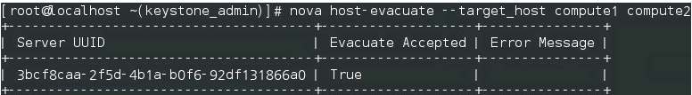
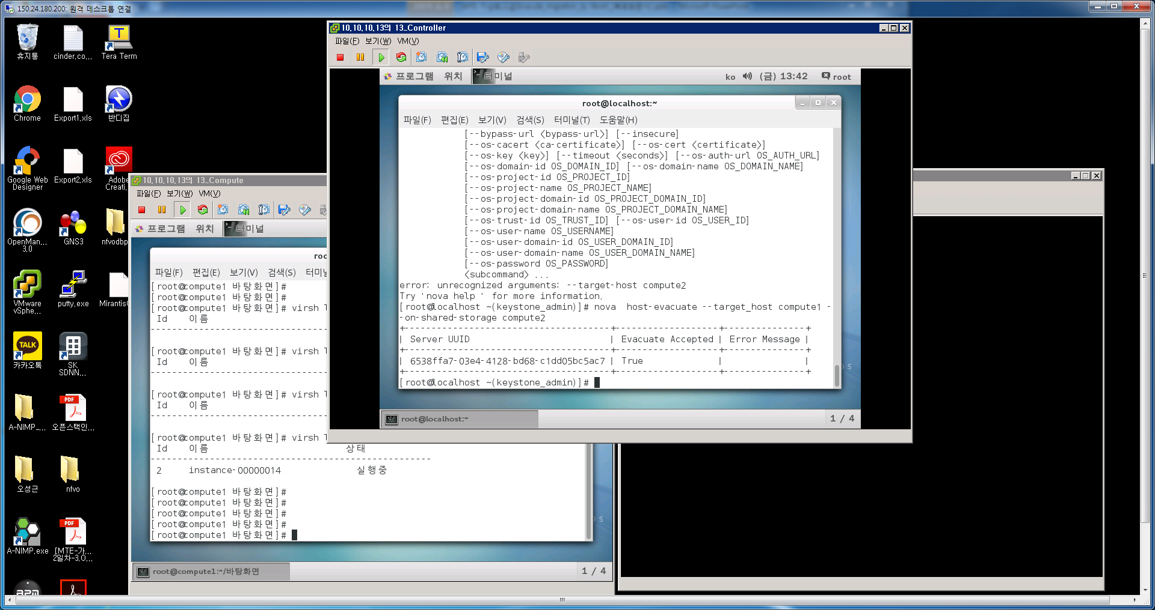
1. Evacuate instance
2-3. Evacuate Host 동작
다. Evacuate host (without shared storage)
$ nova host-evacuate –target_host <target_host> <host> → 원본HOST의 모든 VM을 -> TARGET HOST_B로 시작
라. Evacuate host (with shared storage)
$ nova host-evacuate –target_host <target_host> <host> --on-shared-storage → 원본HOST의 모든 VM을 -> TARGET HOST_B로 시작
※ Evacuate 동작시 유의사항
명령어 실행시 실제 nova compute가 죽어있지 않으면 명령어 실패 발생 (osc 네트워크으로 compute node 상태관리)
※ evacuation이 자동으로 동작하게 하는것은 risk가 있음
Nova compute가 죽어있는지 controller가 인지하는데 1분 이상 소요 kilo 버젼에서 evacuation시 이전 host에 virsh list --all 로 봤을때 VM 이 남아있음 (상용망서 VM이 있어 원복시 주의)
이전 HOST에서 nova.conf파일의 destroy_after_evacuate=true설정하고 이전 HOST에서
systemctl restart openstack-nova-compute.service 또는 reboot해야 VM 상태정상 관리됨
DPDK VM에 대해서는 대상 HOST의 nova.conf에서 paththrough 주소설정 확인필요
인터페이스 down시 양쪽 모두 active에 의한 application Fail이 발생함으로 reboot의로 조치필요

Slide 9
1. Evacuate 시험
2-3. Evacuate 시험(공유스토리지 상태에서 각 인터페이스별로 DOWN하고 시험)
망분류 | 이전 HOST | 대상 HOST | Without storage결과 | With storage결과
OSC 관리망 서비스망 LIVE MIG 망 | x O O | O O O | 비정상 (ERROR) | 정상 (ACTIVE)
OSC 관리망 서비스망 LIVE MIG 망 | x O O | x O O | 비정상 (REBUILD) | 비정상
OSC 관리망 서비스망 LIVE MIG 망 | x O x | O O O | 비정상 (ERROR) | 정상 (ACTIVE)
OSC 관리망 서비스망 LIVE MIG 망 | x O O | O O x | 비정상 (REBUILD) | 비정상 (REBUILD)
OSC 관리망 서비스망 LIVE MIG 망 | x O x | O O x | 비정상 (REBUILD) | 비정상 (REBUILD)
OSC 관리망 서비스망 LIVE MIG 망 | x x O | O O O | 비정상 (ERROR) | 정상 (ACTIVE)
OSC 관리망 서비스망 LIVE MIG 망 | x O O | O x O | 비정상 (ERROR) | 정상/서비스 비정상 (ACTIVE)
OSC 관리망 서비스망 LIVE MIG 망 | x x O | O x O | 비정상 (ERROR) | 정상/서비스 비정상 (ACTIVE)
OSC망: Evacuate이 발생하는 조건을 결정하며 이전 HOST(X) 대상 HOST (O) 상태이여야 함
서비스망: Evacuate 성공과 무관하나 서비스에 영향을 줌
LIVE MIG망: with Storage가 성공하기 위해서는 대상 HOST가 (O)하나 Without Storage로 하면 ERROR발생

Slide 10
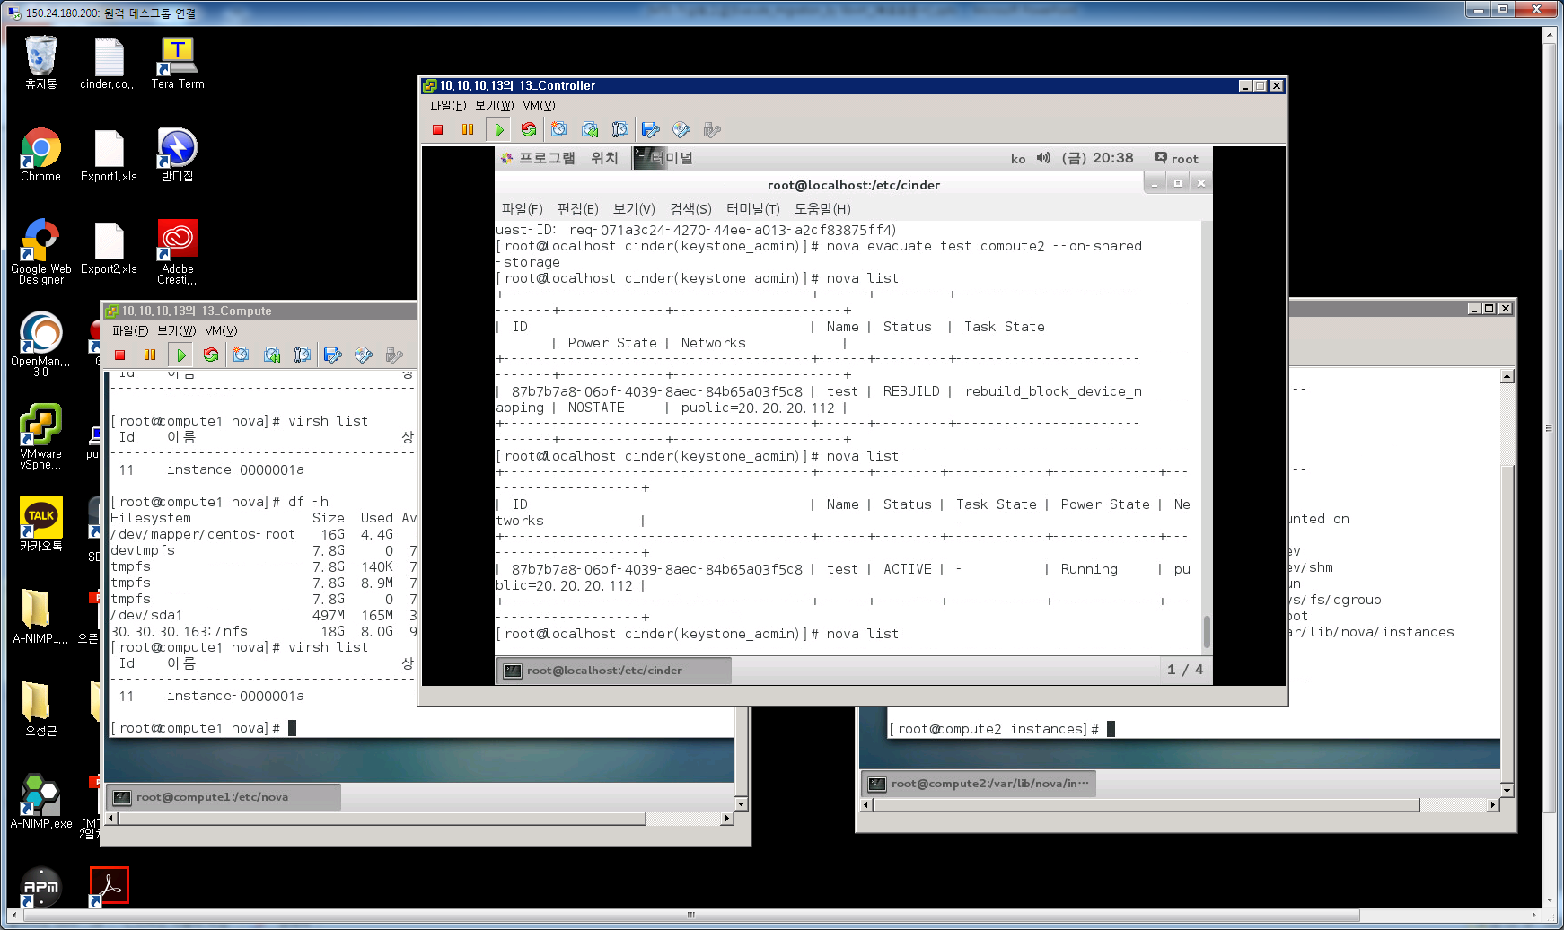
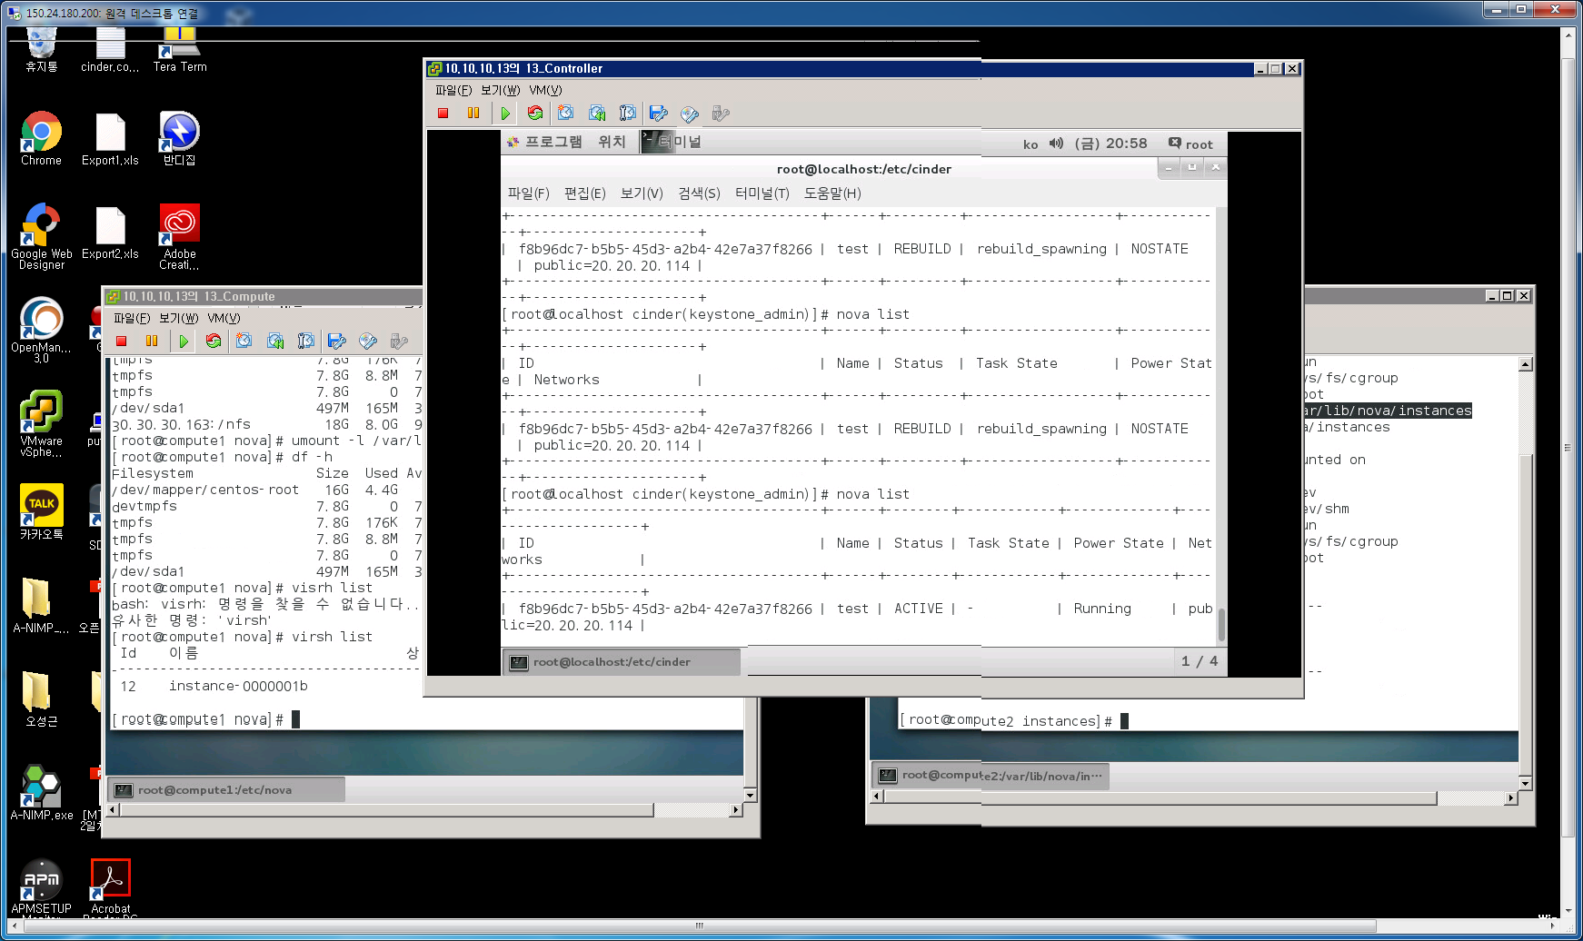
1. Evacuate 시험
2-3. Evacuate Cinder 경우(1번째 disk는 root 2번째 disk는 cinder로 연결된 경우)
망분류 | 이전 HOST | 대상 HOST | With storage결과
OSC 관리망 서비스망 LIVE MIG 망 | x O O | O O O | 정상 (rebuild_block_device-mapping-> ACTIVE)
망분류 | 이전 HOST | 대상 HOST | Without storage결과
OSC 관리망 서비스망 LIVE MIG 망 | x O O | O O O | 정상 (REBUILD->ACTIVE)

Slide 11
1. Evacuate Parameter
2-3. Evacuate Parameter
오픈스택의 COMPUTE HOST의 nova.conf 파일의 parameter
<destroy_after_evacuate=false>
# Whether to destroy instances on startup when we suspect they
# have previously been evacuated. This can result in data loss
# if undesired. See https://launchpad.net/bugs/1419785
# (boolean value)
ㅇ destroy_after_evacuate=false -> evacuation후 이전 host에서 destroy 하지 않음 -> virsh list --all에서 vm 존재
ㅇ destroy_after_evacuate=trun -> evacuation후 이전 host에서 destroy 실행 -> virsh list --all에서 vm 없음
ㅇ service_down_time=60 -> nova service-list의 down->up으로 인지를 check 하는 주기를 결정
- 60->30초로 줄일경우 nova service-list 상태인지를 빨리함

Slide 12
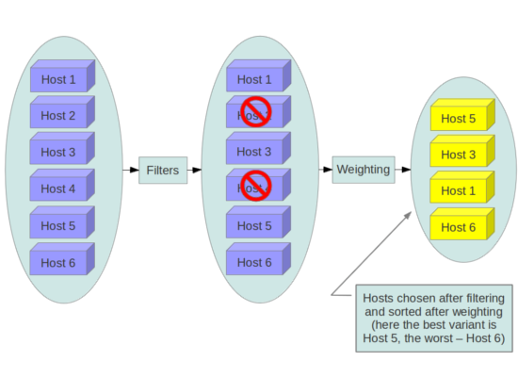
2. Nova Scheduler
Nova scheduler
ㅇ 스케쥴러는 instance가 실행될 물리적인 host를 결정한다.
ㅇ /etc/nova/nova.conf 파일에 configure 구성
scheduler_driver_task_period = 60
scheduler_driver = nova.scheduler.filter_scheduler.FilterScheduler
scheduler_available_filters = nova.scheduler.filters.all_filters
scheduler_default_filters = RetryFilter, AvailabilityZoneFilter, RamFilter, ComputeFilter, ComputeCapabilitiesFilter, ImagePropertiesFilter, ServerGroupAntiAffinityFilter, ServerGroupAffinityFilter
ㅇ 기본 스케쥴러 driver는 filter scheduler로 구성되며 해당 filter에 모두 만족하는 host를 선정
Have not been attempted for scheduling purposes (RetryFilter).
Are in the requested availability zone (AvailabilityZoneFilter).
Have sufficient RAM available (RamFilter).
Can service the request (ComputeFilter).
Satisfy the extra specs associated with the instance type (ComputeCapabilitiesFilter).
Satisfy any architecture, hypervisor type, or virtual machine mode properties specified on the instance's image properties (ImagePropertiesFilter).
Are on a different host than other instances of a group (if requested) (ServerGroupAntiAffinityFilter).
Are in a set of group hosts (if requested) (ServerGroupAffinityFilter)
ㅇ 스케쥴러는 이용가능한 host 목록을 가지고 있으며 scheduler_driver_task_period 주기로 업데이트실시

Slide 13
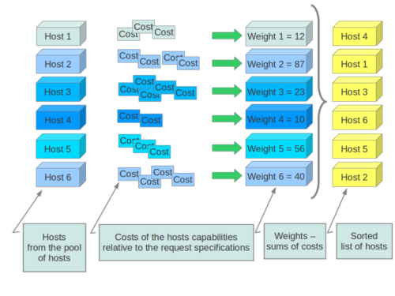
2. Nova Scheduler
Nova scheduler (Host weighting options)
Section | Option | Description
[DEFAULT] | ram_weight_multiplier | By default, the scheduler spreads instances across all hosts evenly. Set the ram_weight_multiplier option to a negative number if you prefer stacking instead of spreading. Use a floating-point value.
[DEFAULT] | scheduler_host_subset_size | New instances are scheduled on a host that is chosen randomly from a subset of the N best hosts. This property defines the subset size from which a host is chosen. A value of 1 chooses the first host returned by the weighting functions. This value must be at least 1. A value less than 1 is ignored, and 1 is used instead. Use an integer value.
[DEFAULT] | scheduler_weight_classes | Defaults to nova.scheduler.weights.all_weighers, which selects the RamWeigher and MetricsWeigher. Hosts are then weighted and sorted with the largest weight winning.
[metrics] | weight_multiplier | Multiplier for weighting metrics. Use a floating-point value.
[metrics] | weight_setting | Determines how metrics are weighted. Use a comma-separated list of metricName=ratio. For example: "name1=1.0, name2=-1.0" results in: name1.value * 1.0 + name2.value * -1.0
[metrics] | required | Specifies how to treat unavailable metrics: True—Raises an exception. To avoid the raised exception, you should use the scheduler filter MetricFilter to filter out hosts with unavailable metrics. False—Treated as a negative factor in the weighting process (uses the weight_of_unavailable option).
[metrics] | weight_of_unavailable | If required is set to False, and any one of the metrics set by weight_setting is unavailable, the weight_of_unavailable value

Slide 14
3. Migration
3-1 Migration
- 한 Host에서 다른 Host로 VM을 이동시키는 기능
- Host 유지보수가 필요하거나 자원을 재분배할 때 유용
3-2 Migration Type
가. Non-live migration (instance가 다른 hypervisor로 이동하는 동안 shutdown됨)
나. Live migration(migration동안 downtime 없이 서비스를 지속하고자 할때 유용)
1) Shared storage-based live migration (메모리만 복사)
- hypervisor가 공유 스토리지에 접근
2) Block live migration (메모리와 블럭디바이스도 복사)
- 공유 스토리지가 불필요. CD-ROM과 같은 read-only 디바이스와 호환되지 않음
3) Volume-backed live migration
- 공유 스토리지가 불필요. ephemeral disk보다 backend volume으로 구성된 경우
(Cinder에 글랜스 이미지를 넣고 instanceA-> instanceB로 변경)

Slide 15
4. Non-live Migration
4-1 Non-live Migration
- scheduler는 설정 기반으로 destination host를 선택
- 공유 스토리지가 필요하지 않음
- 새로운 host에서 부팅되며 configuration(ID, name, IP address)를 보관
[root@osc ~(keystone_admin)]# nova help migrate
usage: nova migrate [--poll] <server>
Migrate a server. The new host will be selected by the scheduler.
Positional arguments:
<server> Name or ID of server.
Optional arguments:
--poll Report the server migration progress until it completes.
[root@osc ~(keystone_admin)]# nova migration-list
+----------------------+----------------------+----------------+--------------+-----------+--------+--------------------------------------+------------+------------+----------------------------+----------------------------+
| Source Node | Dest Node | Source Compute | Dest Compute | Dest Host | Status | Instance UUID | Old Flavor | New Flavor | Created At | Updated At |
+----------------------+----------------------+----------------+--------------+-----------+--------+--------------------------------------+------------+------------+----------------------------+----------------------------+
| vgw31-7.samsung.com | vgw31-s2.samsung.com | vgw31-7 | vgw31-s2 | 127.0.0.1 | error | 37cd13f2-a936-4477-a6e5-6c1c6995e0dd | 43 | 48 | 2015-06-22T05:48:18.000000 | 2015-06-22T05:48:38.000000 |
| vgw31-s2.samsung.com | vgw32-s2.samsung.com | vgw31-s2 | vgw32-s2 | 127.0.0.1 | error | 37cd13f2-a936-4477-a6e5-6c1c6995e0dd | 43 | 48 | 2015-06-22T05:55:45.000000 | 2015-06-22T05:55:46.000000 |
+----------------------+----------------------+----------------+--------------+-----------+--------+--------------------------------------+------------+------------+----------------------------+----------------------------+

Slide 16
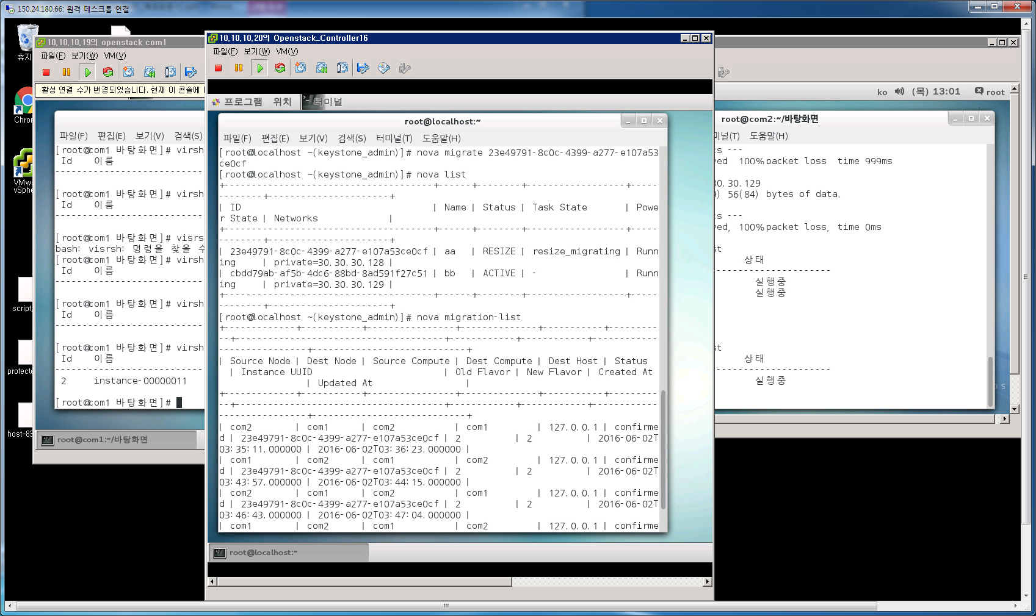
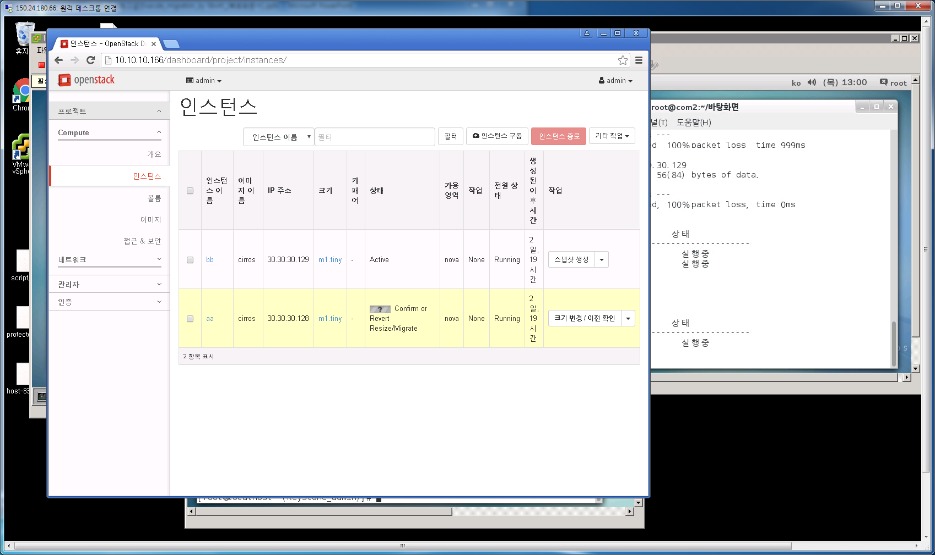
4. Non-live Migration
4-1 Non-live Migration
-> dashborad에서 추가적으로 confirm을 해야함

Slide 17
5. Live Migration with shared storage
5-1 사전요구 사항
- Hypervisor: KVM with libvirt
- Shared storage:/var/lib/nova/instances가 공유storage로 mount되어야 함
- /etc/nova/nova.conf 의 [libvirt] 아래와 같이 설정
live_migration_flag=VIR_MIGRATE_UNDEFINE_SOURCE,VIR_MIGRATE_PEER2PEER,VIR_MIGRATE_LIVE,VIR_MIGRATE_TUNNELLED
5-2 Shared Storage 구성 (shared storage가 mount되지 않은 경우 live migration error 발생)
$ ping HostA - nfs서버 (controller)
$ ping HostB -instance1 (compute1)
$ ping HostC – instance2 (compute2)
$ vi /etc/exports (A)
NOVA-INST-DIR/instances HostA/255.255.0.0(rw,sync,fsid=0,no_root_squash)
# /etc/init.d/nfs-kernel-server restart (A)
# /etc/init.d/idmapd restart (A)
$ chmod o+x NOVA-INST-DIR/instances (A,B,C)
# VI /etc/fatab (B,C)
HostA:/ /NOVA-INST-DIR/instances nfs4 defaults 0 0
# stop libvirt-bin && start libvirt-bin
$ ps -ef | grep libvirt root 1145 1 0 Nov27 ? 00:00:03 /usr/sbin/libvirtd -d -l\ (A,B,C)

Slide 18
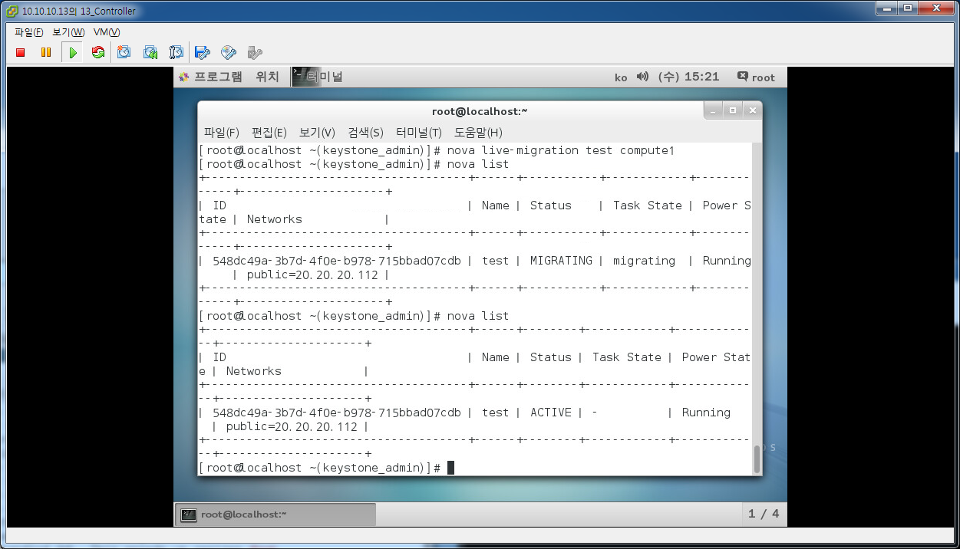
6. Live Migration with shared storage
6-1 controller을 nfs server, compute1, compute2를 nfs client로 설정
※ 사전에 /var/lib/nova/instances를 nfs 공유 storage 인식해야함
MIGRATING-> ACTIVE로 전환됨
[root@osc ~(keystone_admin)]# nova help live-migration
usage: nova live-migration [--block-migrate] [--disk-over-commit]
<server> [<host>]
Migrate running server to a new machine.
Positional arguments:
<server> Name or ID of server.
<host> destination host name.
Optional arguments:
--block-migrate True in case of block_migration.
(Default=False:live_migration)
--disk-over-commit Allow overcommit.(Default=False)

Slide 19
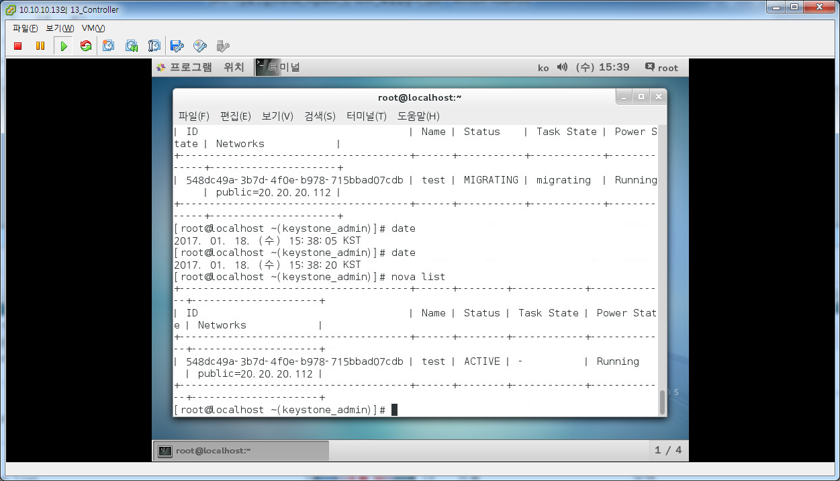
6. Live Migration with shared storage (cinder를 2번째 disk로 가진경우)
6-2 controller을 nfs server, compute1, compute2를 nfs client로 설정
※ 사전에 /var/lib/nova/instances를 nfs 공유 storage 인식해야함
MIGRATING-> ACTIVE로 전환됨
MIGRATIONG 과정에 CINDER 디스크를 띠었다 붙이는 과정이 포함되어 있으므로 시간이 다소 오래소요
MIGRATIONG 과정에 이미 대상 HOST VM이 실행중으로 표기됨 (상용에서 확인필요)

Slide 20
6. Live Migration with shared storage (document)
6-1 Live Migration Parameter (/etc/nova/nova.conf)
Configuration option = Default value |  | Description
[DEFAULT]
live_migration_retry_count = 30 | (IntOpt) Number of 1 second retries needed in live_migration
max_concurrent_live_migrations = 1 | (IntOpt) Maximum number of live migrations to run concurrently. This limit is enforced to avoid outbound live migrations overwhelming the host/network and causing failures. It is not recommended that you change this unless you are very sure that doing so is safe and stable in your environment.
[libvirt]
live_migration_bandwidth = 0 | (IntOpt) Maximum bandwidth(in MiB/s) to be used during migration. If set to 0, will choose a suitable default. Some hypervisors do not support this feature and will return an error if bandwidth is not 0. Please refer to the libvirt documentation for further details
live_migration_completion_timeout = 800 | (IntOpt) Time to wait, in seconds, for migration to successfully complete transferring data before aborting the operation. Value is per GiB of guest RAM + disk to be transferred, with lower bound of a minimum of 2 GiB. Should usually be larger than downtime delay * downtime steps. Set to 0 to disable timeouts.
live_migration_downtime = 500 | (IntOpt) Maximum permitted downtime, in milliseconds, for live migration switchover. Will be rounded up to a minimum of 100ms. Use a large value if guest liveness is unimportant.
live_migration_downtime_delay = 75 | (IntOpt) Time to wait, in seconds, between each step increase of the migration downtime. Minimum delay is 10 seconds. Value is per GiB of guest RAM + disk to be transferred, with lower bound of a minimum of 2 GiB per device
live_migration_downtime_steps = 10 | (IntOpt) Number of incremental steps to reach max downtime value. Will be rounded up to a minimum of 3 steps
live_migration_flag = VIR_MIGRATE_UNDEFINE_SOURCE, VIR_MIGRATE_PEER2PEER, VIR_MIGRATE_LIVE, VIR_MIGRATE_TUNNELLED | (StrOpt) Migration flags to be set for live migration
live_migration_progress_timeout = 150 | (IntOpt) Time to wait, in seconds, for migration to make forward progress in transferring data before aborting the operation. Set to 0 to disable timeouts.
live_migration_uri = qemu+tcp://%s/system | (StrOpt) Migration target URI (any included "%s" is replaced with the migration target hostname)

Slide 21
6. Live Migration parameter (상용장비)
6-1 Live Migration Parameter (/etc/nova/nova.conf)
항목 | 설명
live_migration_retry_count = 30 | (Integer) Maximum number of 1 second retries in live_migration. It specifies number of retries to iptables when it complains. It happens when an user continously sends live-migration request to same host leading to concurrent request to iptables. Possible values: Any positive integer representing retry count.
live_migration_bandwidth = 0 | (Integer) Maximum bandwidth(in MiB/s) to be used during migration. If set to 0, will choose a suitable default. Some hypervisors do not support this feature and will return an error if bandwidth is not 0. Please refer to the libvirt documentation for further details
Live_migration_flag | VIR_MIGRATE_UNDEFINE_SOURCE,VIR_MIGRATE_PEER2PEER,VIR_MIGRATE_LIVE,VIR_MIGRATE_TUNNELLED
Block_migration_flag | VIR_MIGRATE_UNDEFINE_SOURCE,VIR_MIGRATE_PEER2PEER,VIR_MIGRATE_LIVE,VIR_MIGRATE_TUNNELLED VIR_MIGRATE_NON_SHARED_INC
Migrate_max_retries=-1 | Number of times to retry live-migration before falling if ==-1 , try until out of hosts. if ==0, only try once, no retries

Slide 22
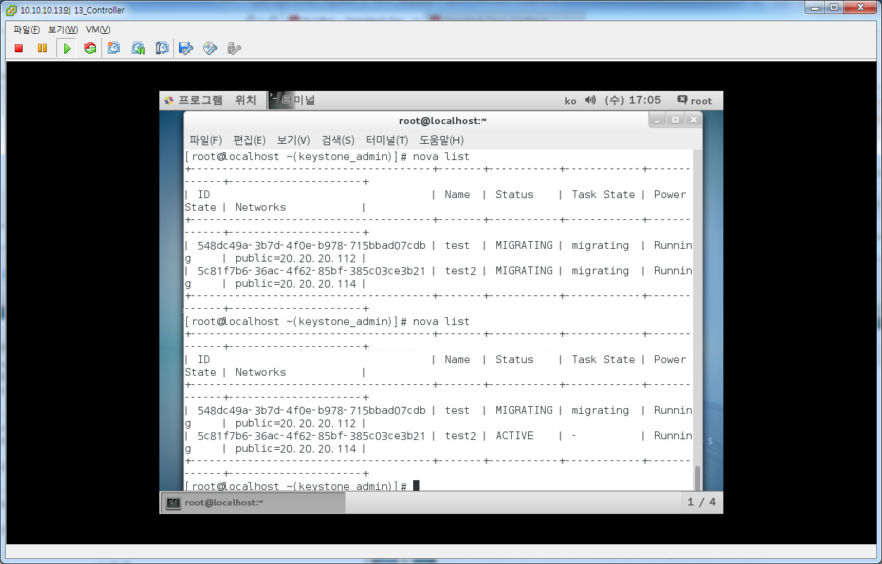
6. Live Migration parameter (동시진행 TEST)
6-1 Live Migration Parameter (/etc/nova/nova.conf)
ㅇ 시험필요사항
동시 2대 진행시 cinder없는vm이 있을 경우 동시진행됨
cinder있는 vm을 동시진행하면 하나만 진행됨
2. openstack live_migration timtout(800*(32+1) , NFVO timeout(1200초) 이므로 NFVO timeout 시점까지 기달려야함

Slide 23
1. Live Migration 시험
2-3. Live Migration (공유스토리지 상태에서 각 인터페이스별로 DOWN하고 시험)
망분류 | 이전 HOST | 대상 HOST | Block-migrate | With storage결과
OSC 관리망 서비스망 LIVE MIG 망 | x O O | O O O |  | 비정상(멈춤)
OSC 관리망 서비스망 LIVE MIG 망 | O O O | x O O |  | 비정상(멈춤)
OSC 관리망 서비스망 LIVE MIG 망 | O O x | O O O |  | 비정상(멈춤)
OSC 관리망 서비스망 LIVE MIG 망 | O O O | O O x |  | 비정상(멈춤)
OSC 관리망 서비스망 LIVE MIG 망 | O x O | O O O |  | 정상 (ACTIVE)
OSC 관리망 서비스망 LIVE MIG 망 | O O O | O x O |  | 정상/서비스 비정상 (ACTIVE)
OSC 관리망 서비스망 LIVE MIG 망 | O x O | O x O |  | 정상/서비스 비정상 (ACTIVE)
OSC망: Live migration 발생하는 이전 HOST(O) , 대상 HOST (O) 상태이여야 함 (명령어 멈춤상태)
서비스망: Live migration 성공과 무관하나 서비스에 영향을 줌
LIVE MIG망: Live migration 발생하는 이전 HOST(O) , 대상 HOST (O) 상태이여야 함 (명령어 멈춤상태)

Slide 24
7. Block Live Migration
7. Block migration
- No NFS client or server configuration is required.
- To use block migration, you must use the --block-migrateparameter with the live migration command
- Block migration is incompatible with read-only devices such as CD-ROMs
- Since the ephemeral drives are copied over the network in block migration, migrations of instances with heavy I/O loads may never complete if the drives are writing faster than the data can be copied over the network
[root@osc ~(keystone_admin)]# nova help live-migration
usage: nova live-migration [--block-migrate] [--disk-over-commit]
<server> [<host>]
Migrate running server to a new machine.
Positional arguments:
<server> Name or ID of server.
<host> destination host name.
Optional arguments:
--block-migrate True in case of block_migration.
(Default=False:live_migration)
--disk-over-commit Allow overcommit.(Default=False)

Slide 25
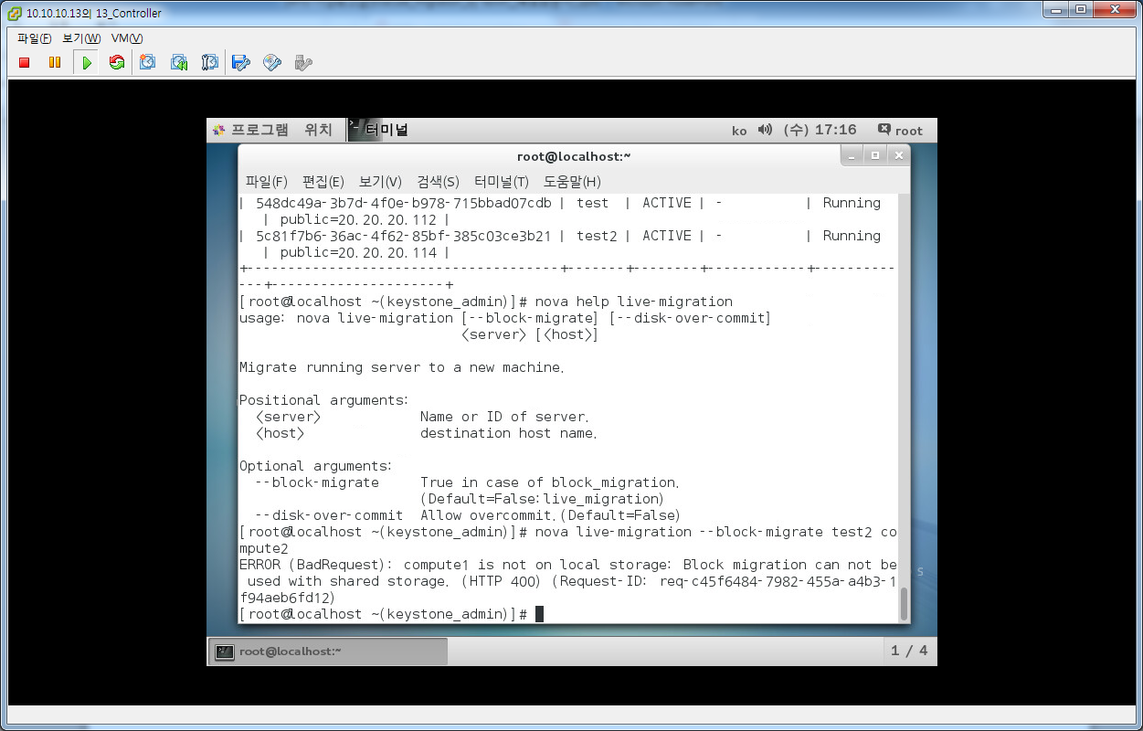
7. Block Live Migration
7. Block migration
ㅇ compute node에서 config 설정확인
/etc/nova/nova.conf live_migration_flag=VIR_MIGRATE_UNDEFINE_SOURCE,VIR_MIGRATE_PEER2PEER,VIR_MIGRATE_LIVE
/etc/libvirt/libvirtd.conf listen_tls = 0 listen_tcp = 1 auth_tcp = “none”
ㅇ compute node에서 해당 서비스 restart
systemctl restart openstack-nova-compute.service
systemctl restart libvirtd.service
ㅇ 공유스토리지가 구성된 경우는 error발생하고 동작하지 않음

Slide 26
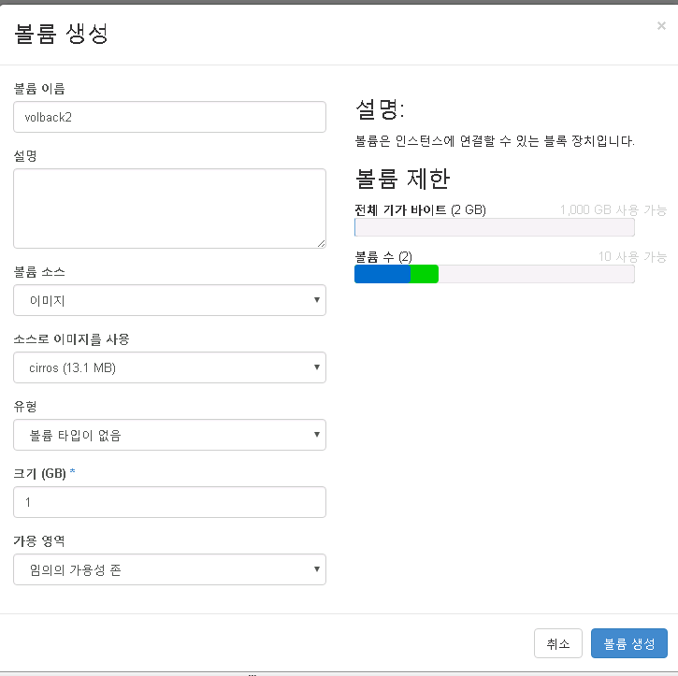
8. Volume backend Live Migration
8. Volume backend Live Migration
ㅇ image를 넣은 cinder 볼륨을 사전에 생성

Slide 27
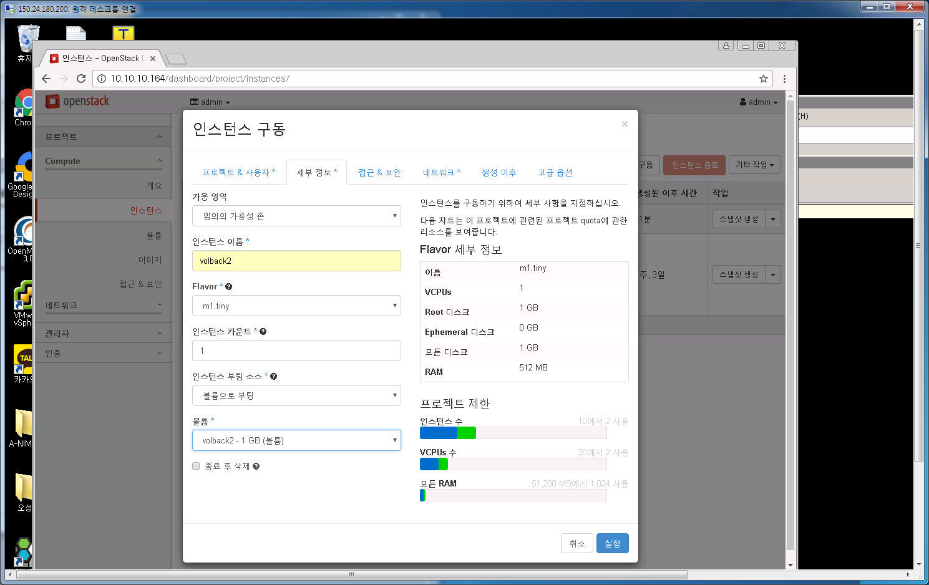
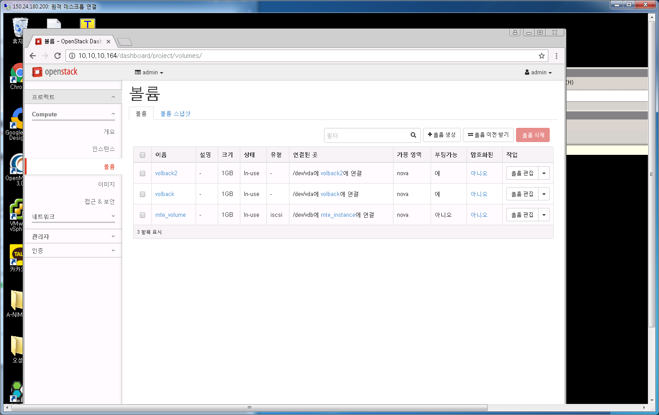
8. Volume backend Live Migration
8. 인스턴스 생성시 해당 볼륨을 부팅소스로 지정
볼륨이 vda로 인스턴스에 붙음

Slide 28
8. Volume backend Live Migration
8. nova live-migration volback2로 실행하면
nova의 compute1->compute2로 변경됨 (nova show volbakc2로 확인)

Slide 29
9. Voulme Migration
volume migration CASE
If the volume is not attached, the Block Storage service creates a volume and copies the data from the original to the new volume
If the volume is attached to a VM instance, the Block Storage creates a volume, and calls Compute to copy the data from the original to the new volume. Currently this is supported only by the Compute libvirt driver.
Cinder 백앤드 pool이 2개이상 필요함
[root@controller instances(keystone_admin)]# cinder get-pools
+----------+----------------------+
| Property | Value |
+----------+----------------------+
| name | controller@lvm2#lvm2 |
+----------+----------------------+
+----------+--------------------+
| Property | Value |
+----------+--------------------+
| name | controller@lvm#lvm |
+----------+--------------------+
[root@controller instances(keystone_admin)]# cinder-manage host list
host zone
controller@lvm nova
controller nova
controller@lvm2 nova

Slide 30
9. Voulme Migration
volume migration 전 상태
[root@controller instances(keystone_admin)]# openstack volume show test
+--------------------------------+--------------------------------------+
| Field | Value |
+--------------------------------+--------------------------------------+
| attachments | [] |
| availability_zone | nova |
| bootable | false |
| consistencygroup_id | None |
| created_at | 2016-11-16T01:19:14.000000 |
| description | |
| encrypted | False |
| id | 2e22d4ee-5c25-4097-9ecf-1ed44009703f |
| migration_status | None |
| multiattach | False |
| name | test |
| os-vol-host-attr:host | controller@lvm#lvm |
| os-vol-mig-status-attr:migstat | None |
| os-vol-mig-status-attr:name_id | None |
| os-vol-tenant-attr:tenant_id | 0be48fa7946e4ff984c36e1ea14fea4d |
| properties | |
| replication_status | disabled |
| size | 1 |
| snapshot_id | None |
| source_volid | None |
| status | available |
| type | iscsi |
| updated_at | 2016-11-16T01:19:16.000000 |
| user_id | e71fa010292b4f3898af3f0d688739fc |
+--------------------------------+--------------------------------------+
os-vol-host-attr:host - the volume’s current back end.
os-vol-mig-status-attr:migstat - the status of this volume’s migration (None means that a migration is not currently in progress).
os-vol-mig-status-attr:name_id - the volume ID that this volume’s name on the back end is based on. Before a volume is ever migrated, its name on the back end storage may be based on the volume’s ID (see the volume_name_template configuration parameter). For example, if volume_name_template is kept as the default value (volume-%s), your first LVM back end has a logical volume named volume-6088f80a-f116-4331-ad48-9afb0dfb196c. During the course of a migration, if you create a volume and copy over the data, the volume get the new name but keeps its original ID. This is exposed by the name_id attribute

Slide 31
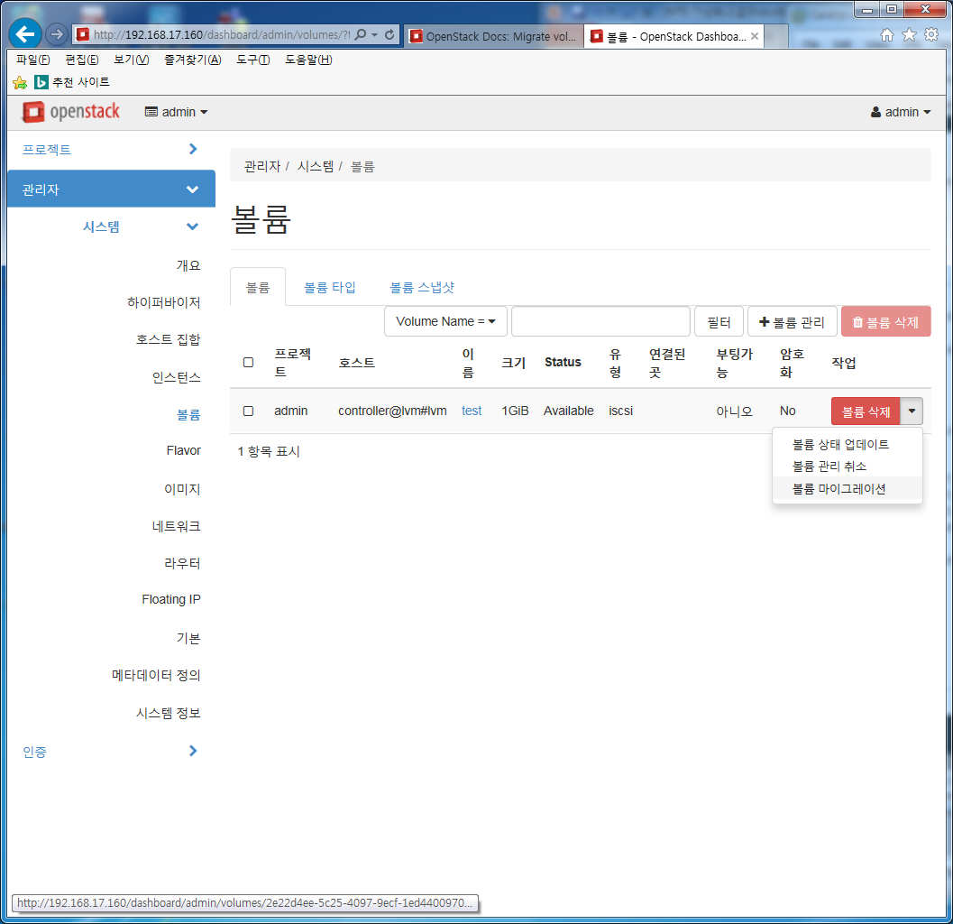
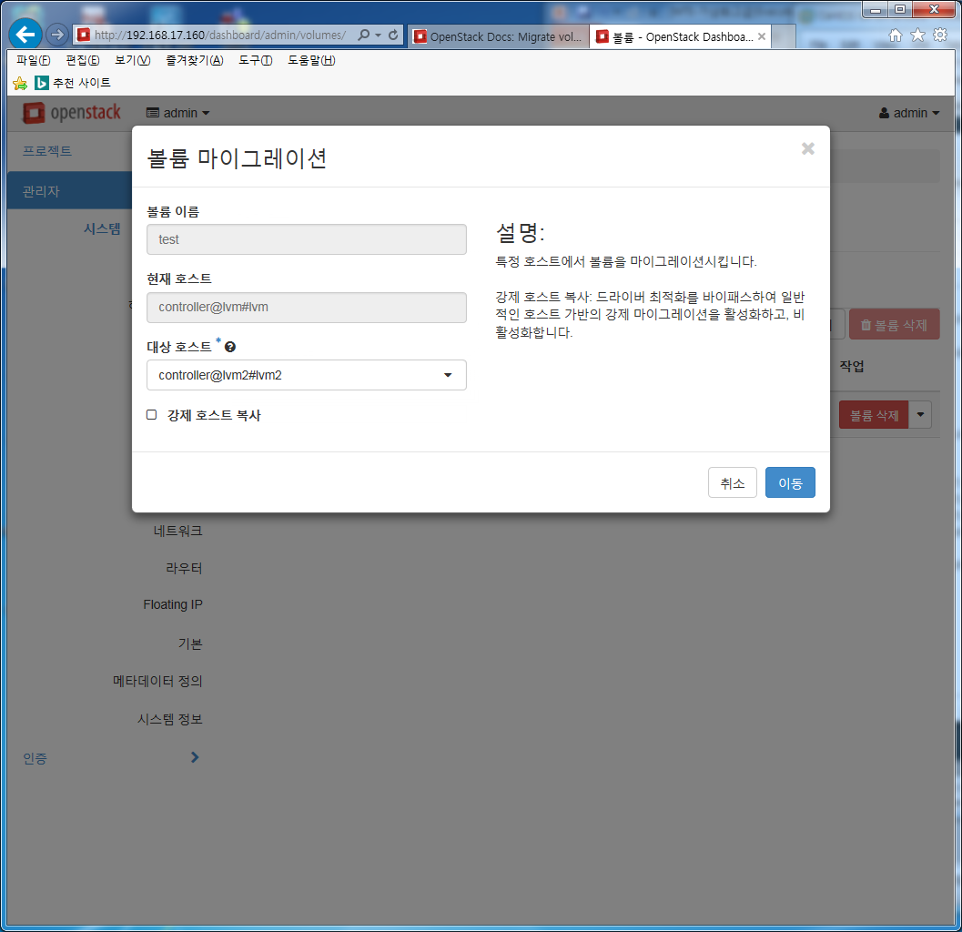
9. Voulme Migration

Slide 32
9. Voulme Migration
volume migration 후 상태
--------------------------------+--------------------------------------+
[root@controller instances(keystone_admin)]# openstack volume show test
+--------------------------------+--------------------------------------+
| Field | Value |
+--------------------------------+--------------------------------------+
| attachments | [] |
| availability_zone | nova |
| bootable | false |
| consistencygroup_id | None |
| created_at | 2016-11-16T01:19:14.000000 |
| description | |
| encrypted | False |
| id | 2e22d4ee-5c25-4097-9ecf-1ed44009703f |
| migration_status | error |
| multiattach | False |
| name | test |
| os-vol-host-attr:host | controller@lvm#lvm |
| os-vol-mig-status-attr:migstat | error |
| os-vol-mig-status-attr:name_id | None |
| os-vol-tenant-attr:tenant_id | 0be48fa7946e4ff984c36e1ea14fea4d |
| properties | |
| replication_status | disabled |
| size | 1 |
| snapshot_id | None |
| source_volid | None |
| status | available |
| type | iscsi |
| updated_at | 2016-11-16T02:20:17.000000 |
| user_id | e71fa010292b4f3898af3f0d688739fc |
+--------------------------------+--------------------------------------+
+--------------------------------+--------------------------------------+

